Slide 1
Installation of Neo4j

Slide 2
Download Neo4j
First, download a copy of Neo4j from the Neo4j download page. You can choose from either a free Enterprise Trial, or the free Community Edition.
This tutorial uses the Community Edition.
To download, simply click the Download button. Your download should start automatically.
Install Neo4j
Once the file has downloaded, you can install Neo4j.
The download screen includes step by step instructions on installing Neo4j on to your operating system.

Slide 3
Windows(exe)
Launch the installer you just downloaded. You might have to give the installer permission to make changes to your computer.
Follow the prompts, and choose the option to Run Neo4j.
Click on the Start button to start the Neo4j server.
Open the provided URL in your local web browser.
Change the password for the neo4j account.

Slide 4
Linux/UNIX Install (tar)
Open up your terminal/shell.
Extract the contents of the archive, using: tar -xf <filecode>.
For example,
tar -xf neo4j-enterprise-2.3.1-unix.tar.gz the top level directory is referred to as NEO4J_HOME
Run Neo4j using $NEO4J_HOME/bin/neo4j console. Instead of ‘neo4j console’, you can use neo4j start to start the server process in the background.
Visit http://localhost:7474 in your web browser.
Change the password for the neo4j account.

Slide 5
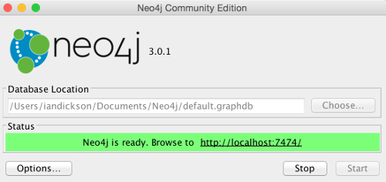
Starting and Connecting to the Neo4j
1.Start the Server
The installation instructions include instructions for starting the Neo4j server. The exact method you use will depend on your operating system.
For example, on a Mac, clicking Neo4j Community Edition from the Applications folder will launch this screen that allows you to start the Neo4j server.
Once the server has been started, open the following URL in your web browser: http://localhost:7474/ and follow the prompts.
Below are the screens I encountered when logging in for the first time (note that future versions may be different).

Slide 6
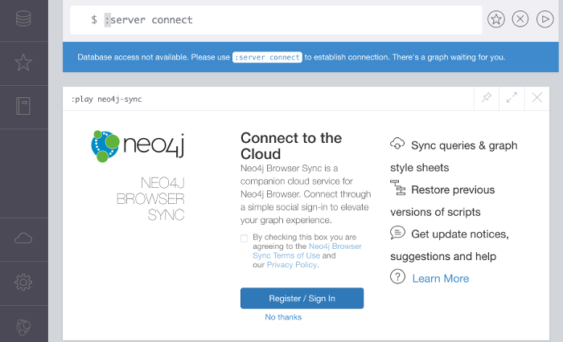
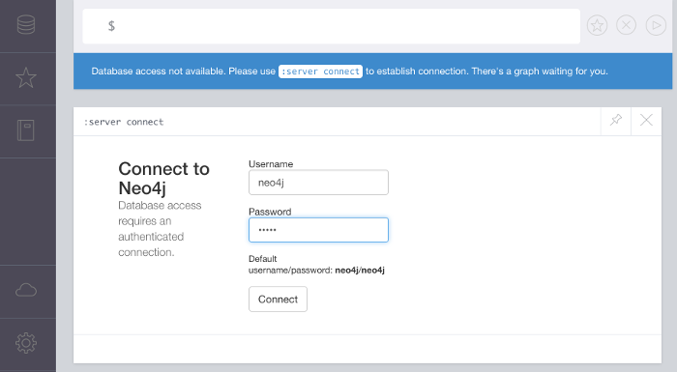
2.Connect to Neo4j
You can either create an account for the cloud service or click No thanks
Log in using the username and password provided on
the screen.
The first time you log in you will be prompted to change your password.
3.Log In

Slide 7
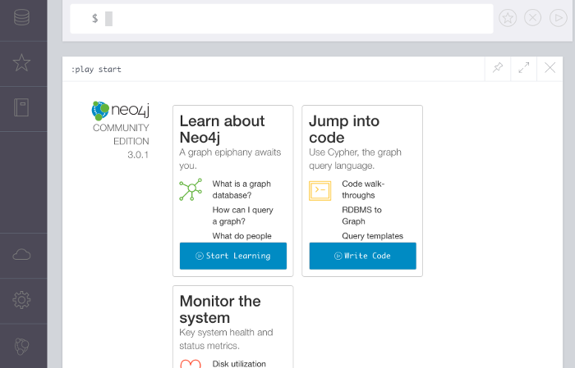
4.The Result
Once the password has been changed, this screen is displayed.
Here, you can use the links to learn more about Neo4j and how to create databases and run queries.

Slide 8

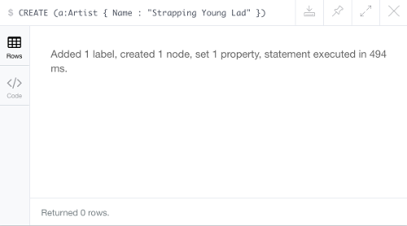
Operations in Neo4j
Neo4j has its own query language called Cypher. Cypher uses a similar syntax to SQL (Structured Query Language).
To create nodes and relationships using Cypher, use the CREATE statement.
Creating a Node:
CREATE (a:Artist { Name : "Strapping Young Lad" })
Once Neo4j has created the node, you should see a message like this:

Slide 9
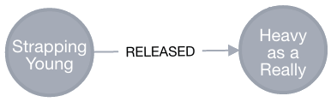
Displaying the Node
CREATE (b:Album { Name : "Heavy as a Really Heavy Thing", Released : "1995" })
RETURN b
The CREATE statement creates the node but it doesn't display the node.
To display the node, you need to follow it up with a RETURN statement.
Creating Relation between Nodes
MATCH (a:Artist),(b:Album)
WHERE a.Name = "Strapping Young Lad" AND b.Name = "Heavy as a Really Heavy Thing"
CREATE (a)-[r:RELEASED]->(b)
RETURN r
It creates the following relationship:

